Slide 1


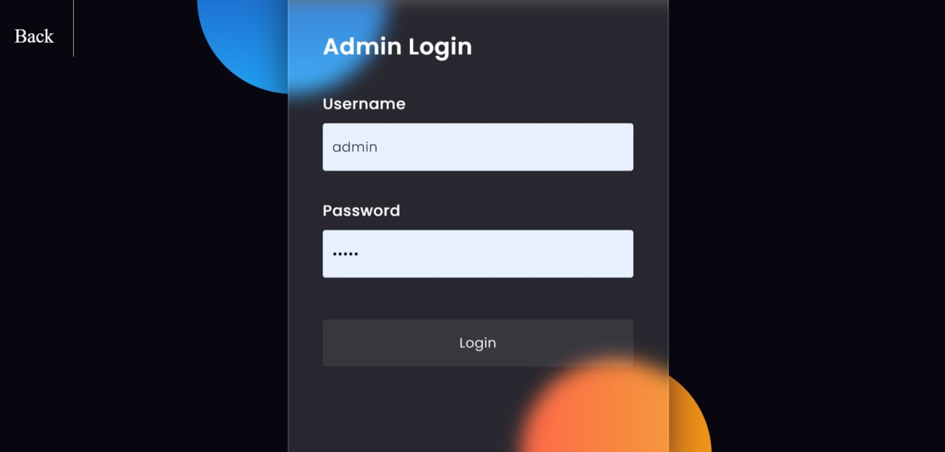
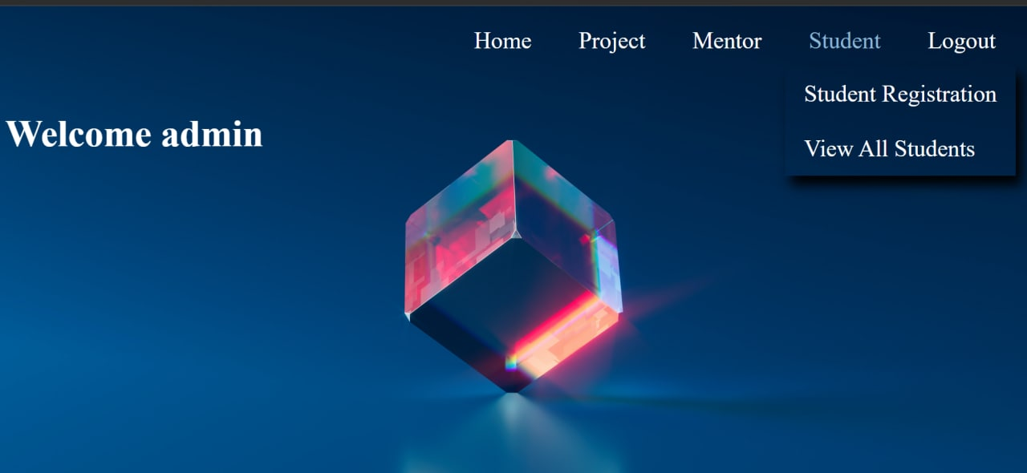
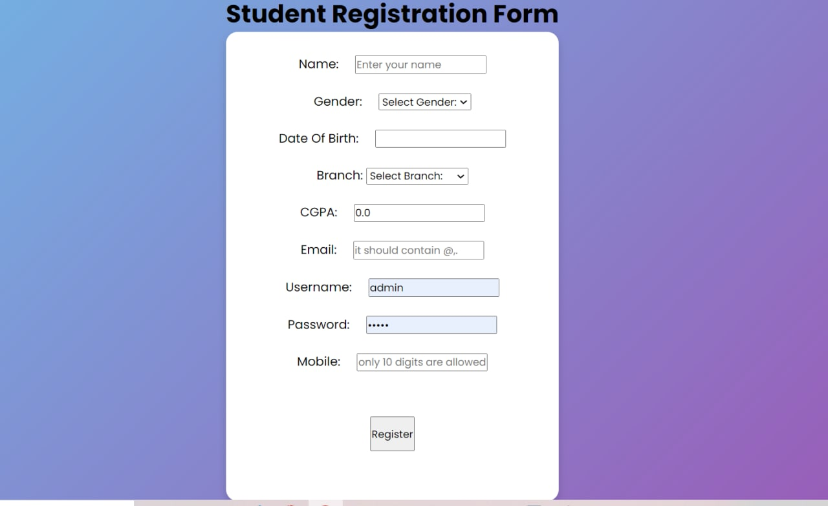
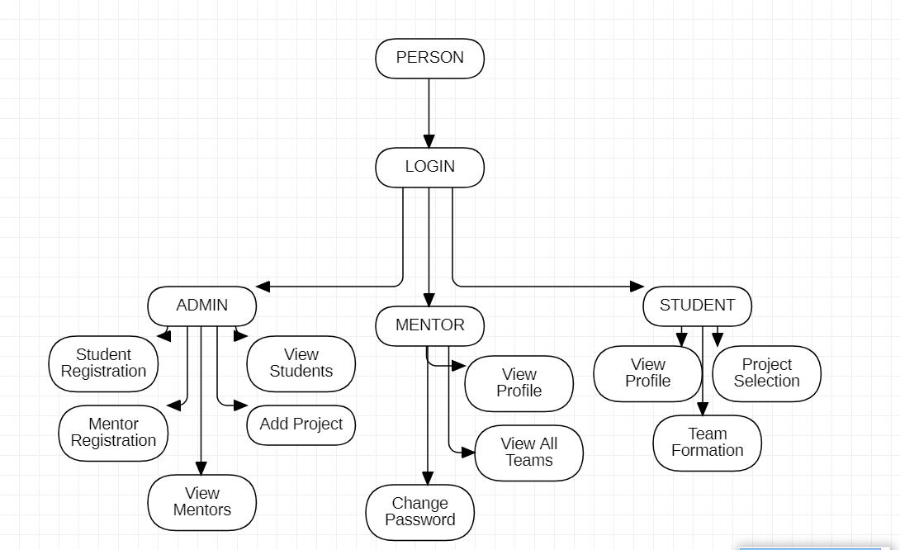
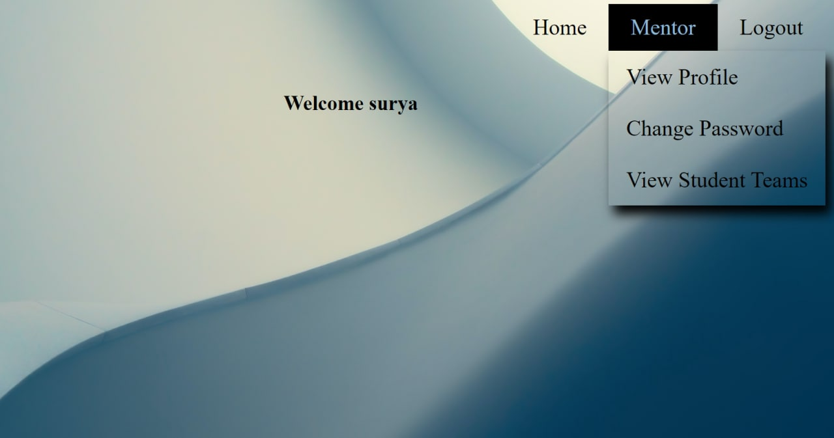
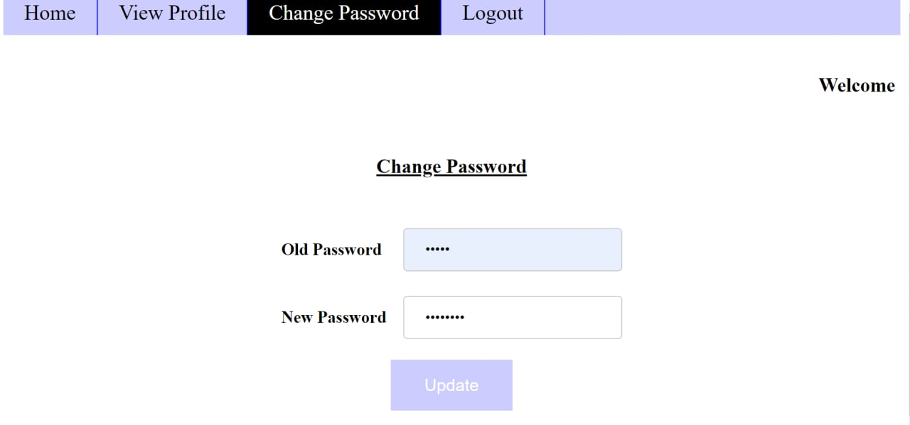
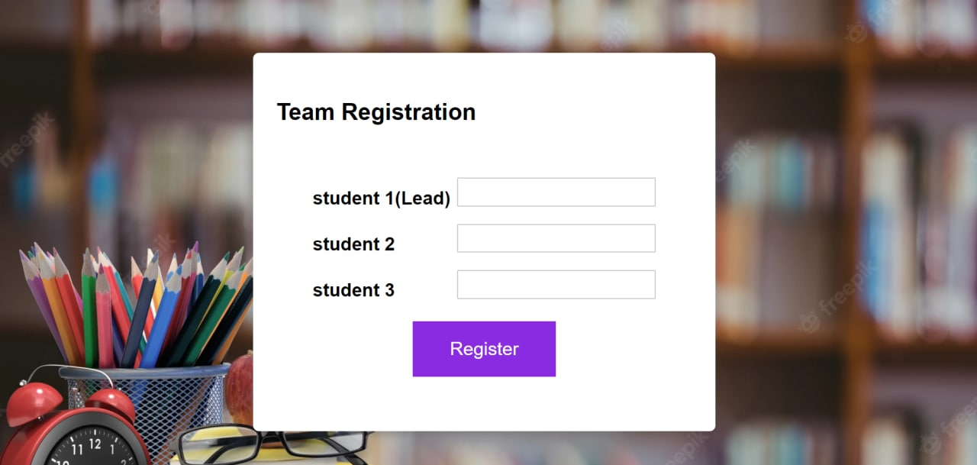
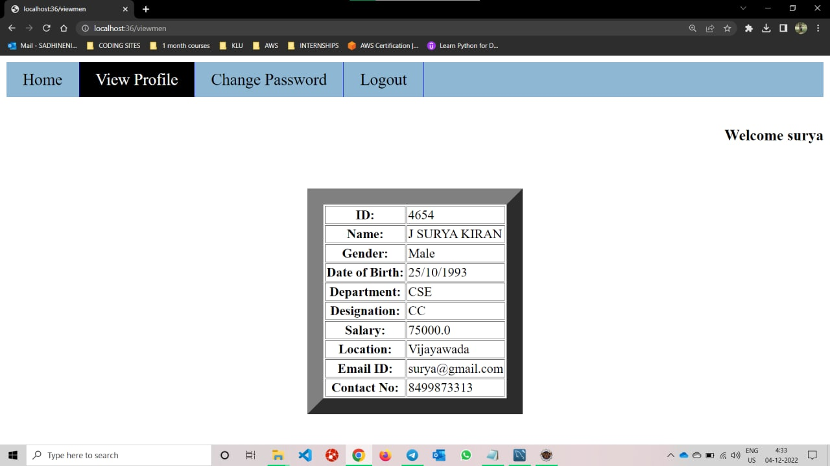
Include Project Title Here
ID-Name of Students separated by comma
Department of CSE(Honors), KLEF
Introduction
Modules
Output Screenshots
Problem Statement
ADMIN
STUDENT
MENTOR
Admin will have access to all three modules and will allocate projects and mentor accordingly.
Students will form a team and then they will register to a project and mentor accordingly.
Mentor will assign tasks to students based on their projects and they will track the progress of projects.
Proposed Solution
Block Diagram
If wrong password is entered it will redirect again to the login page.
The individual Team data and status is easy to access.
Reduce the duplicate data
Image
Project Advantages
Resource Allocation
Reduce Unnecessary meetings
Better access
With the project management software, you can be assured that you have access 24×7.
Irrespective of whether you are in your home or in your office, you can access it anytime.
Notes:
Problem Statement, Proposed Solution then Advantages of Proposed Solution [First Column]
Modules – Mention modules with their operations [Second Column] Block Diagram – System Architecture / Project Flow [Second Column] Output Screenshots – Use this space to include your project screenshots in such a way that all images must be of same size and properly aligned (You can include images side by side also). You can add one more slide of same size to include more screenshots.

